Slide 1
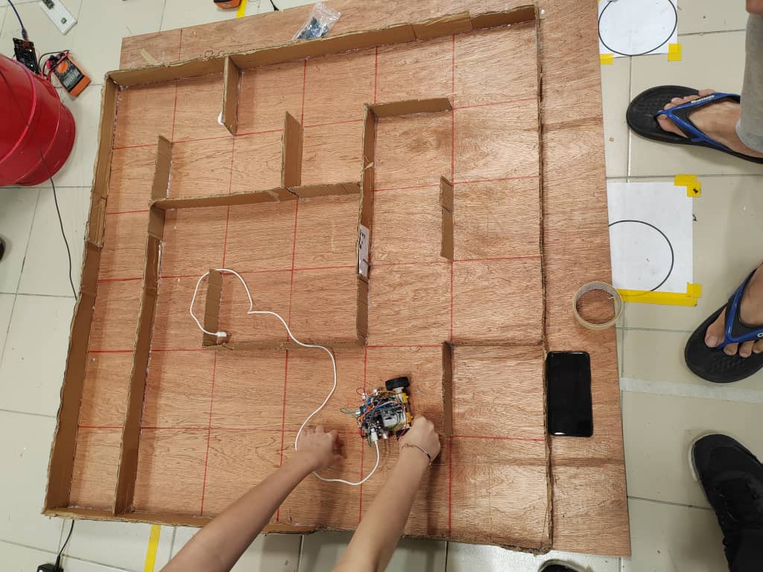
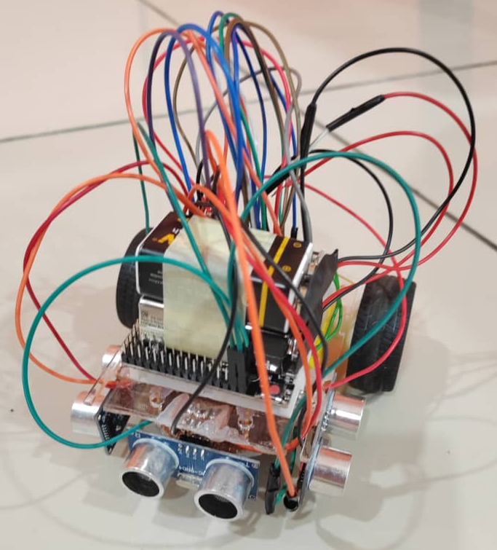
KIE1008 PROGRAMMING II ASSIGNMENT
Team members:
Man Kai Sheng 22004646/1
Yap Jing Wey 22004647/1
Yvone Loh Jing Yi 22004615/1
Lee Yin Shao 22004677/1

Slide 2
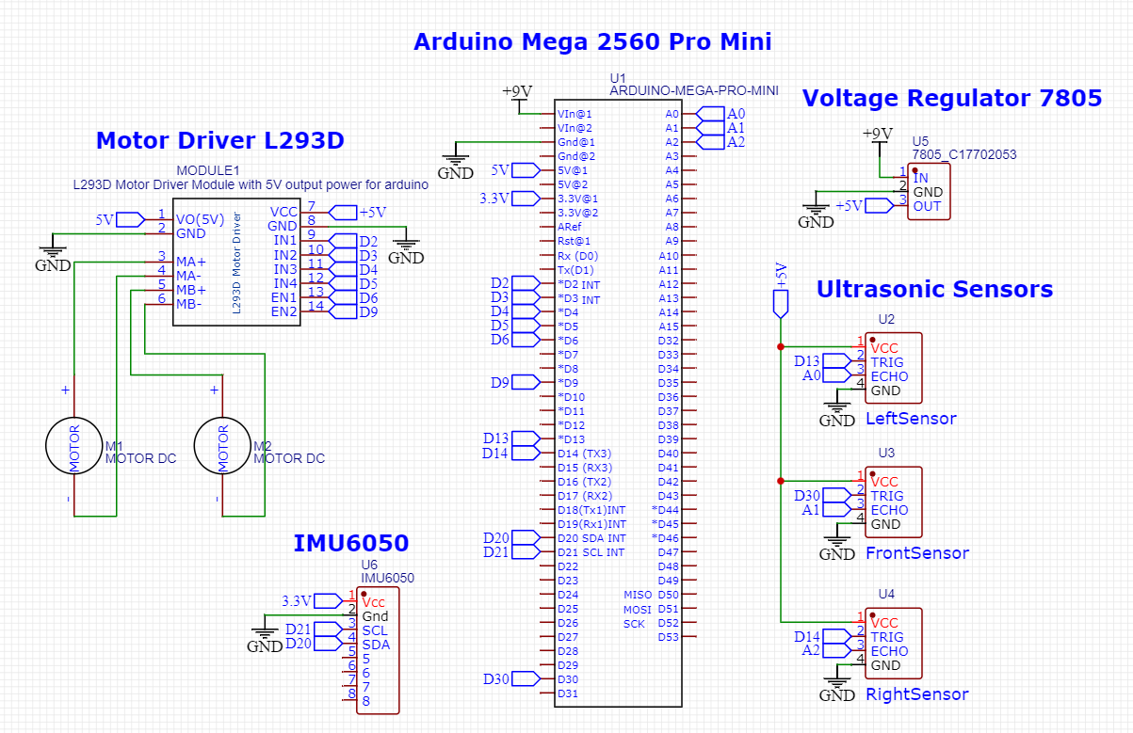
Schematic drawing

Slide 3
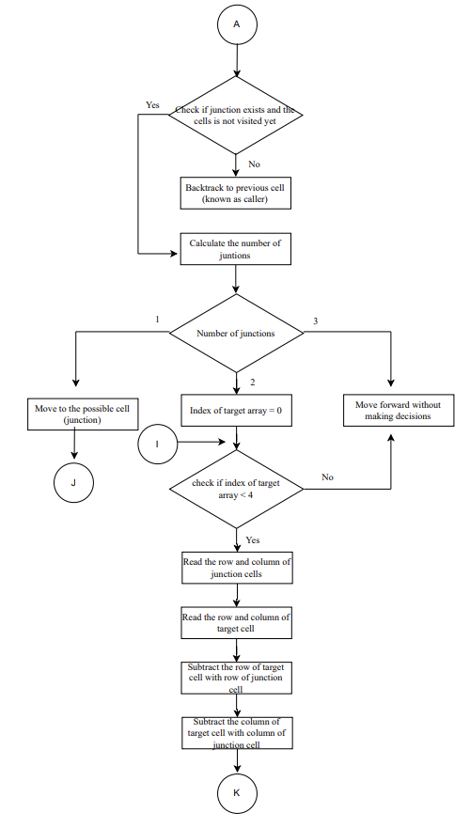
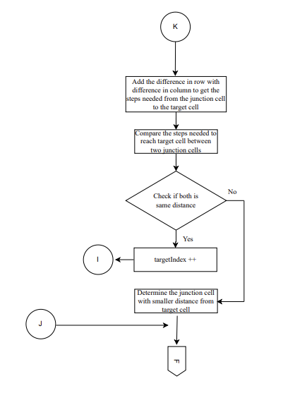
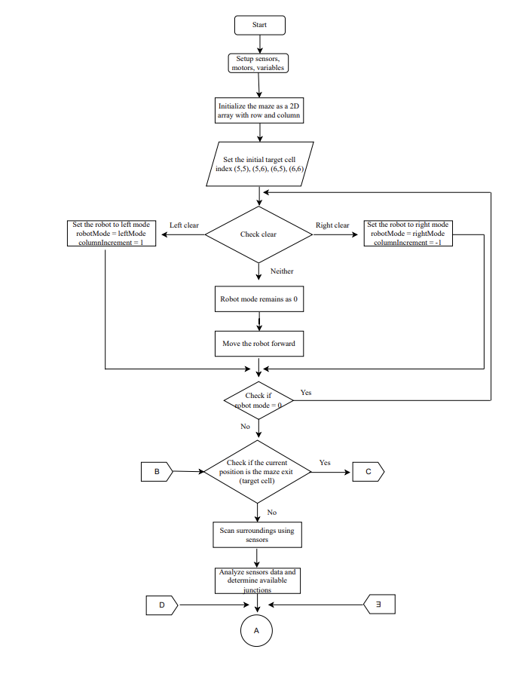

Slide 4
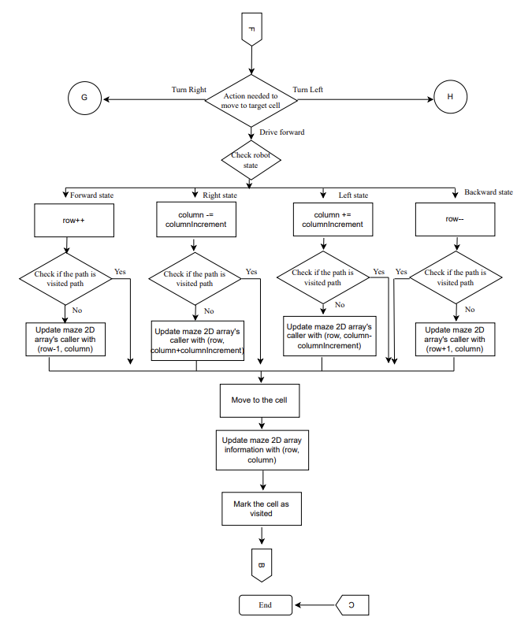
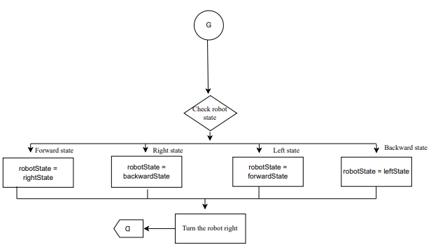
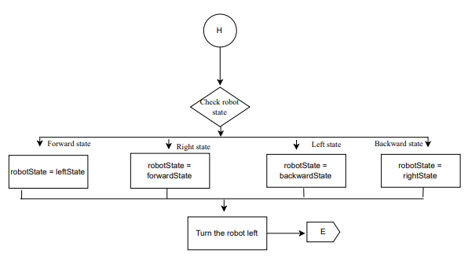

Slide 5

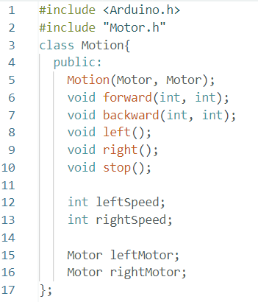
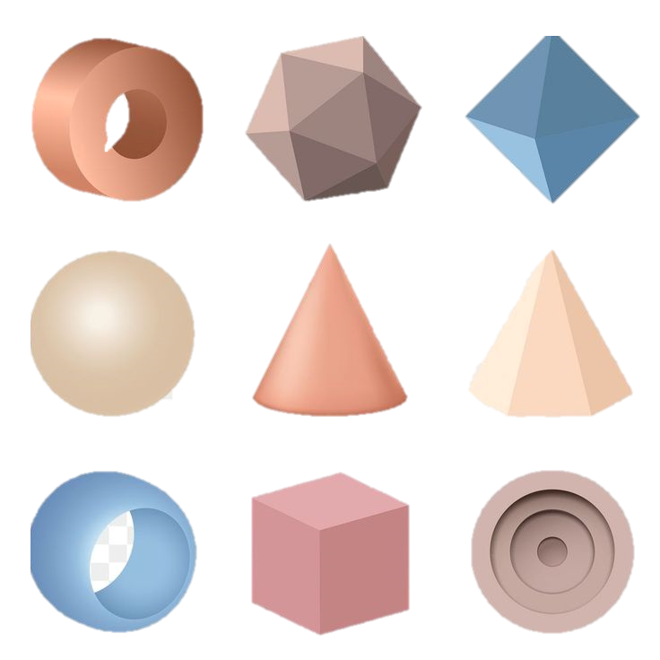
OOP Element
Composition
Object of one class as a member data of another class
Motor
Motion
In Motion class,
we create objects
(leftMotor, rightMotor) of
Motor class

Slide 6

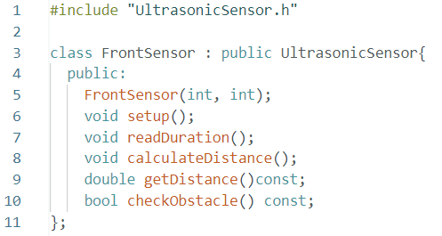
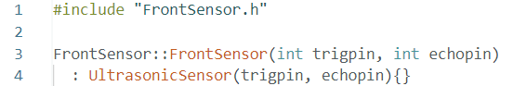
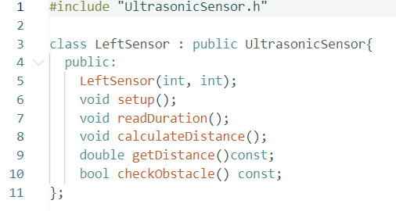

Inheritance
Consists of base class and derived class, new class inherits the members of existing class
Base class: UltrasonicSensor
Derived class: FrontSensor
Constructor in FrontSensor class:
We also implement inheritance in LeftSensor, RightSensor class:
LeftSensor.h
RightSensor.h

Slide 7

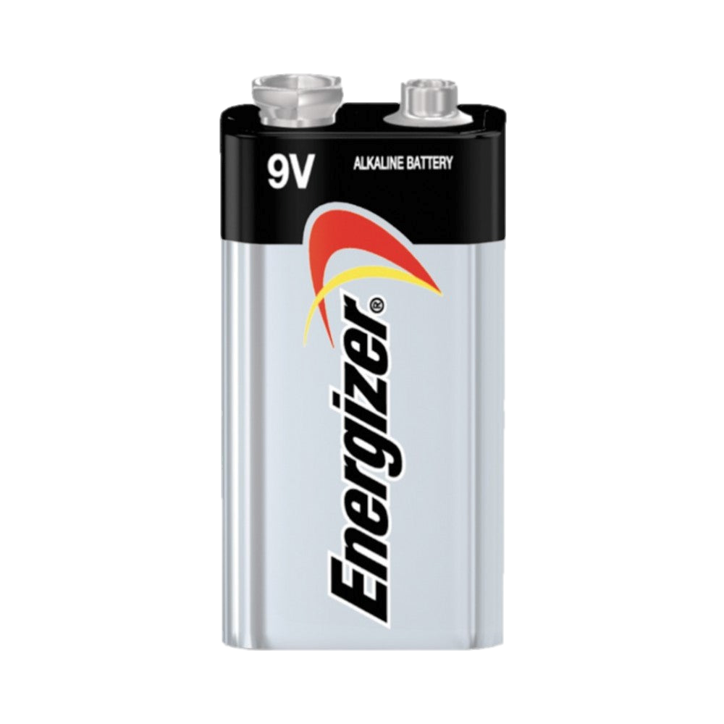
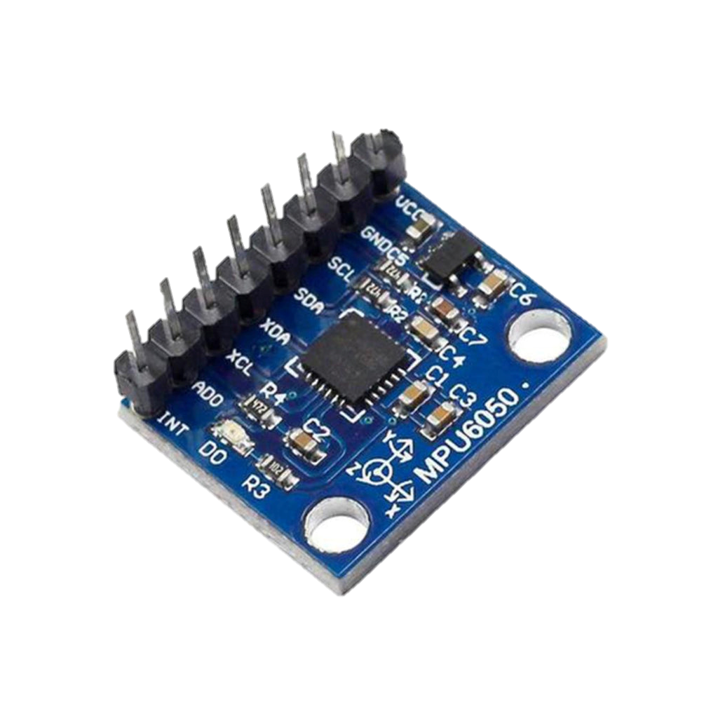
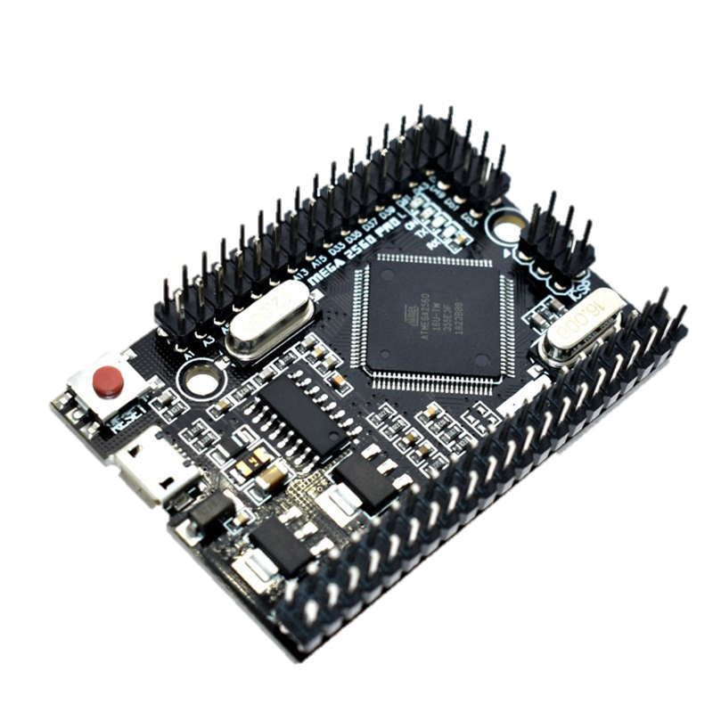
Hardware Limitations
1
2
3
Power Supply
Insufficient memory
Precision in Position Control
Batteries (low power) runs out quickly
Have to use Arduino Mega 2560 Pro with larger memory than Arduino Uno
We use IMU sensor instead of encoder
Encoders: Provide real-time feedback, enabling the robot's control system to make immediate adjustments to ensure straight-line motion. Move from one cell to another cell with the precise distance
IMU: Require additional processing to derive position information, which might introduce delays. Integration error: accumulation of errors that arise during the process of integrating angular rate measurements over time
Energizer (Non-Rechargeable Battery) – Expensive, Hold longer
Beston (Rechargeable Battery) – Run out quickly, takes long time (approximately 2 hours) to charge
9V battery is insufficient to support both motor driver and arduino
Arduino Uno - Program memory (32 kilobytes) and RAM (2 kilobytes)
Arduino Mega 2560 Pro - Program memory (256 kilobytes) and RAM (8 kilobytes)

Slide 8


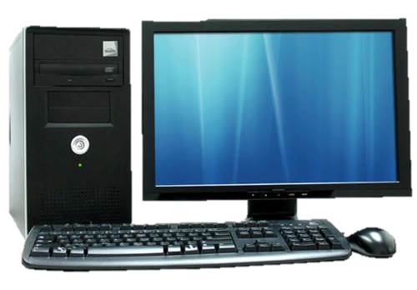

Software Limitations
1
2
3
Limited Development Environment Features
Algorithm Complexity
Absence of encoder coding
Arduino IDE is designed for simplicity, lacking some features found in more advanced development environments.
We keep the maze-solving algorithm simple and well-optimized to ensure that it can run effectively on the Arduino Mega 2560 Pro without exceeding its computational capabilities.
Without encoder data, the reliance on other sensors, such as ultrasonic sensors, becomes more critical for navigation.
- Inaccurate distance - Hard to control speed - Susceptible to uneven surfaces, variations in wheel slippage, or changes in battery voltage
We import TimedAction library which initially do not have in Arduino IDE

Slide 9


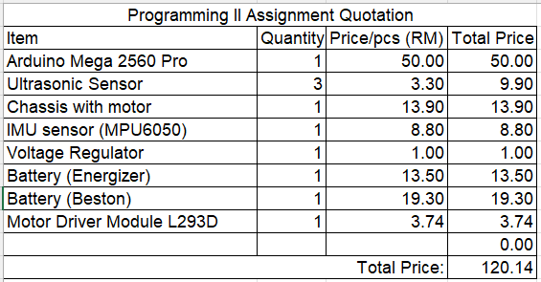




Robot Budget Table

Slide 10

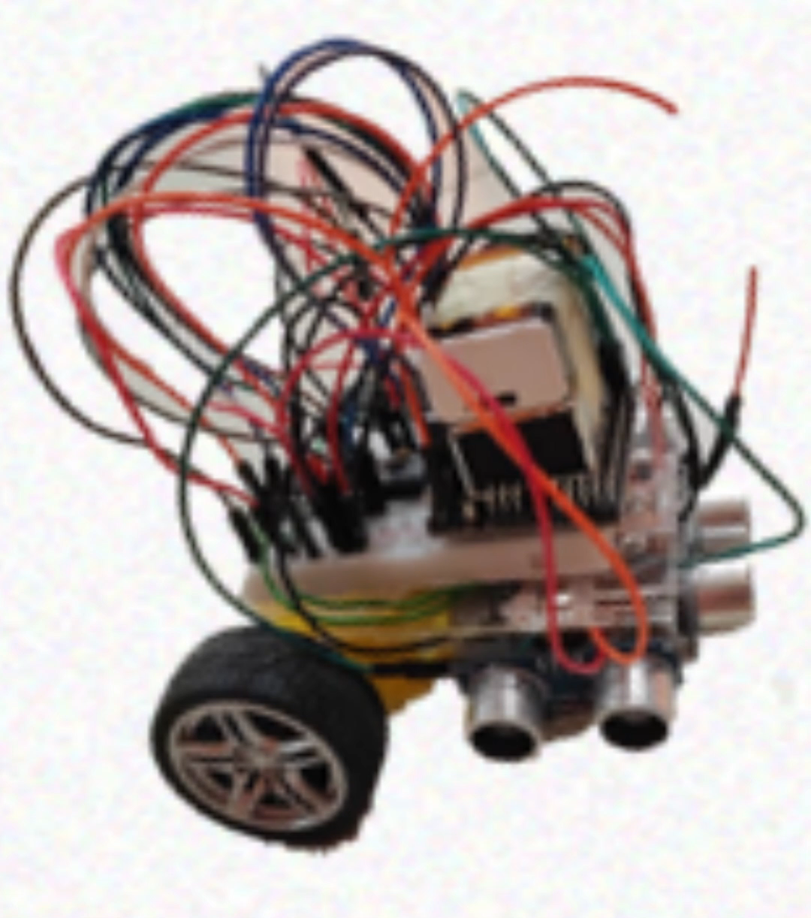
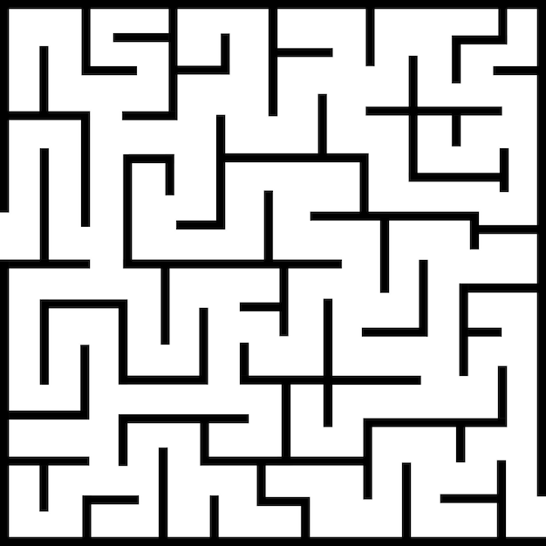
Thanks!

